Slide 1


BTech IV Year VII Semester Section:
BCSE0103: SOFT COMPUTING
(Artificial Neural Network)
Dr. Dilip Kumar Sharma
SM(IEEE, ACM, CSI), Fellow IETE, Fellow IE(I)
Professor- Dept. of Computer Engineering & Applications
Dean (International Relations & Academic Collaborations)
GLA University, Mathura, INDIA
Email: dilip.sharma@gla.ac.in
https://www.gla.ac.in/academics/faculty-detail/7/prof-dilip-kumar-sharma

Slide 2
BCSE0103: SOFT COMPUTING
Objective: Students will get an insight of the intelligent computational approaches. Providing students, the mathematical background to carry out optimization.
Neural Networks: Introduction to Soft Computing & Neural Computing, Fundamentals of Artificial Neural Network(ANN), Models of ANN, ANN models: Rosenblatt’s Perception, McCulloch & Pitts Model, Single Layer Perceptron, Learning Methods in Perceptron, Linearly Separable Task and XOR Problem, Multi-Layer Perceptron, Back Propagation Learning Algorithm, Associative Memory: Hopfield network, Auto Associative Memory, Bidirectional Hetro-Associative Memory, ADALINE, MADALINE Network, Applications of Neural Network.
Fuzzy Logic: Introduction to Fuzzy Sets & Crisp Sets, Fuzzy Membership and Fuzzy Operations, Properties of Fuzzy Sets- Linguistic Hedges, Fuzzy Logic – T-norms and other aggregation operators, Crisp Relations.

Slide 3
BCSE0103: SOFT COMPUTING
Fuzzy Logic: Fuzzy Relations, Fuzzy System, Crisp Logic, Propositional Logic and its Laws, Inference in Propositional Logic, Fuzzy Logic, Inference in Fuzzy Logic (GMP and GMT), Fuzzy Rule Based System, Fuzzyfication & Defuzzification, Applications of Fuzzy Logic.
Genetic Algorithm(GA):Introduction to GA, Search optimization Method, Evolutionary Algorithm Working Principle, Biological Background of GA, Working Principles of GA, Encoding(Binary, Value, Permutation, Tree), Operators of GA(Random Population, Reproduction or Selection), Crossover and Mutation, Basics of Genetic Algorithm with Examples, Introduction to Genetic programming
Text Books:
S. Rajsekaran& G.A. VijayalakshmiPai, “Neural Networks, Fuzzy Logic and Genetic Algorithm: Synthesis and Applications”, 4th Edition, Prentice Hall of India,2003.

Slide 4
BCSE0103: SOFT COMPUTING
Reference Books:
Timothy J Ross ,"Fuzzy Logic with Engineering Applications", 3rd Edition, John Wiley and Sons,2016.
David E. Goldberg ,"Genetic Algorithm in Search Optimization and Machine Learning "Adission-Wesley,2009.
Karray, “Soft Computing and Intelligent Systems Design: Theory, Tools and Applications”, 1st Edition, Pearson Education,2009.
Outcome: After completion of course, student will be able to:
CO1: Understand basics of Soft Computing including Artificial Neural Networks, Fuzzy Logic and Genetic Algorithms.
CO2: Demonstrate the ability to develop some familiarity with current research problems and research methods in Soft Computing by working on a research or design project.
CO3: Understand about the fundamental theory and concepts of neural networks, neuro modeling, several neural networks paradigms and its applications.
CO4: Design and implement the concepts of knowledge using fuzzy inference systems and other machine intelligence applications.
CO5: Identify an evolutionary computing paradigm known as genetic algorithms and its applications to engineering optimization problems.

Slide 5

Agenda
Introduction to Soft Computing
Concept of computing
Important characteristics of ”Computing”
Soft computing vs. ”Hard” Computing
Few examples of Soft computing applications
Characteristics of Soft computing
Hybrid computing

Slide 6
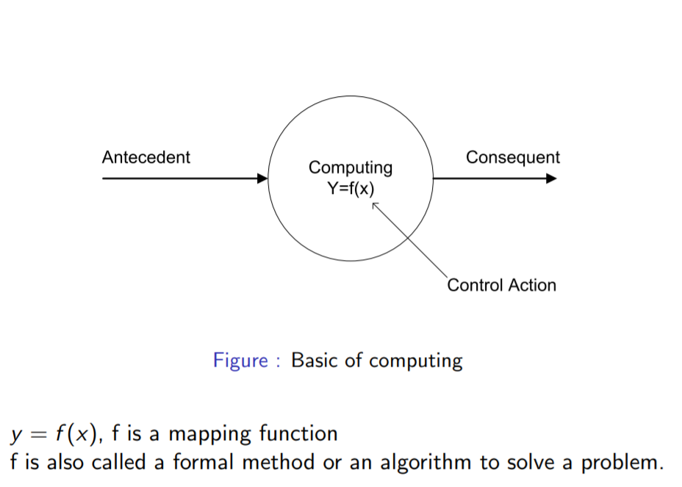
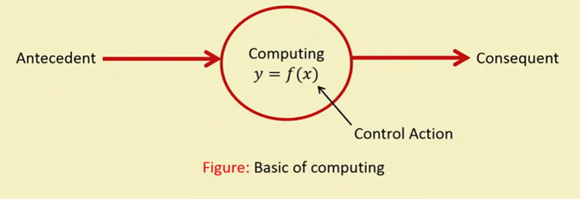
Concept of Computing

Slide 7
Important Characteristics of Computing
Should provide precise solution.
Control action should be unambiguous and accurate.
Suitable for problem, which is easy to model mathematically

Slide 8
Hard Computing
In 1996, LA Zade (LAZ) introduced the term hard computing.
According to LAZ: We term a computing as ”Hard” computing, if
Precise result is guaranteed
Control action is unambiguous
Control action is formally defined (i.e. with mathematical model or algorithm)
Example of Hard Computing:
Solving numerical problems (e.g. Roots of polynomials, Integration etc.)
Searching and sorting techniques
Solving ”Computational Geometry” problems (e.g. Shortest tour in Graph theory, Finding closest pair of points etc.)

Slide 9
Problem Areas of Hard Computing
Problems in some other areas of applications
Medical diagnosis
Person identification
Computer vision
Hand written character recognition
Pattern recognition and Machine Intelligence MI
Weather forecasting

Slide 10
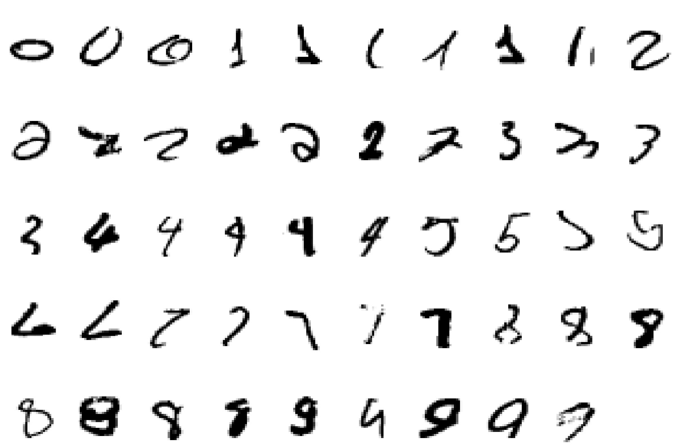
A classic example of a task that requires machine learning: It is very hard to say what makes a 2

Slide 11
Some more examples of tasks that are best solved by using a learning algorithm
Recognizing patterns:
Facial identities or facial expressions
Handwritten or spoken words
Medical images
Recognizing anomalies:
Unusual sequences of credit card transactions
Unusual patterns of sensor readings in a nuclear power plant or unusual sound in your car engine.
Prediction:
Future stock prices or currency exchange rates

Slide 12
Some more examples….
Some web-based examples of machine learning are….
The web contains a lot of data. Tasks with very big datasets often use machine learning
especially if the data is noisy or non-stationary.
Spam filtering, fraud detection:
The enemy adapts so we must adapt too.
Recommendation systems:
Lots of noisy data. Million dollar prize!
Information retrieval:
Find documents or images with similar content.

Slide 13
Soft Computing
The term soft computing was proposed by the inventor of fuzzy logic, Lofti A. Zadeh. He describes it as follows.
Definition:-Soft computing is a collection of methodologies that aim to exploit the tolerance for imprecision and uncertainty to achieve tractability, robustness, and low solution cost, Its principal constituents are fuzzy logic ,neuro-computing, and probabilistic reasoning.
The role model for soft computing is the human mind.

Slide 14
Characteristics of Soft Computing
It does not require any mathematical modeling of problem solving.
It may not yield the precise solution
Algorithms are adaptive (i.e. it can adjust to the change of dynamic environment)
Use some biological inspired methodologies such as genetics, evolution, Ant’s behaviors, particles swarming, human nervous systems etc.

Slide 15
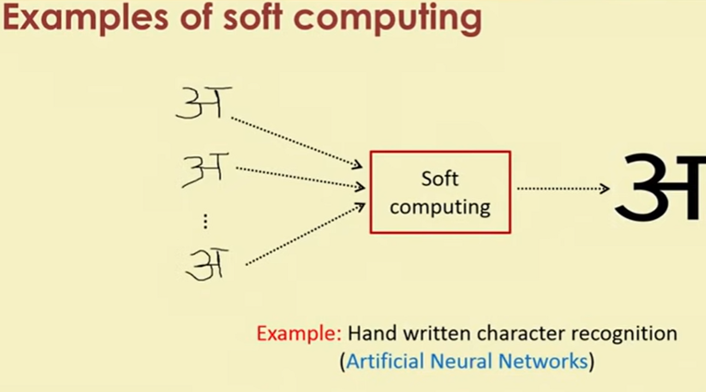


Slide 16
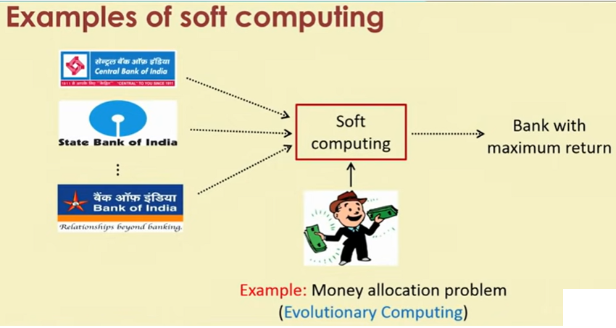

Slide 17
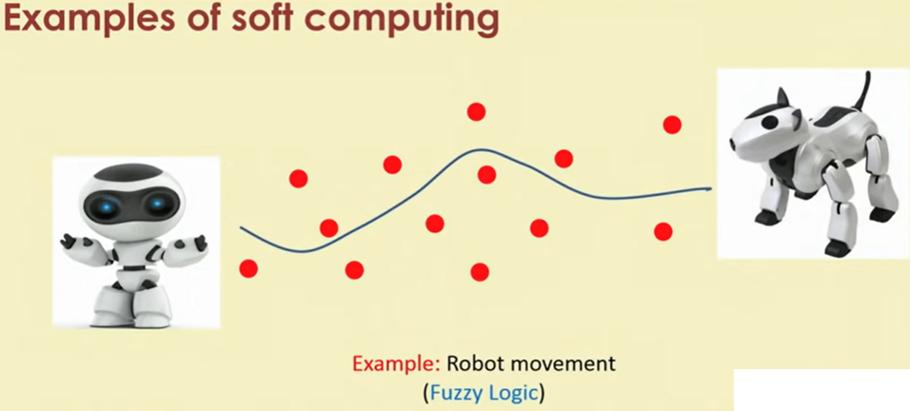

Slide 18
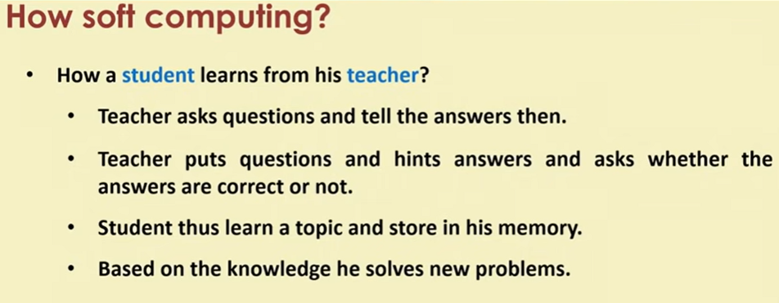
How Soft Computing?
How a student learns from his teacher?
Teacher asks questions and tell the answers then.
Teacher puts questions and hints answers and asks whether the answers are correct or not.
Student thus learn a topic and store in his memory.
Based on the knowledge he solves new problems.
This is the way how human brain works.
Based on this concepts Artificial Neural Networks is used to solve problem

Slide 19
How Soft Computing?
How world selects the best?
It starts with a population(random).
Reproduces another population(Next Generation).
Rank the population and selects the superior individuals.
Genetic Algorithm is based on this natural phenomena.
Population is synonymous to solutions.
Selection of superior is synonymous to exploring the optimal solution.

Slide 20
How Soft Computing?
How a doctor treats his patient?
Doctor asks the patient about suffering.
Doctor find the symptoms of diseases.
Doctor prescribed tests and medicines.
This is exactly the way Fuzzy logic works.
Symptoms are correlated with diseases with uncertainty
Doctor prescribes tests/medicines fuzzily.

Slide 21
Hard Computing vs Soft Computing
Hard Computing | Soft Computing
It requires a precisely stated analytical model and often a lot of Computation time | It is tolerant of imprecision, uncertainty, partial truth and approximation
It is based on binary logic crisp system, numerical analysis and crisp software. | It is based on fuzzy logic, neural nets and probabilities reasoning.
It has the characteristics of precision and categoricity. | It has the characteristics of approximation and dispositionality

Slide 22
Hard Computing vs Soft Computing
Hard Computing | Soft Computing
It is deterministic | It incorporates stochasticity
It requires exact input data | It can deal with ambiguous and noisy data
It is strictly sequential. | It allows parallel computations
It produces precise answers | It can yield approximate answers

Slide 23
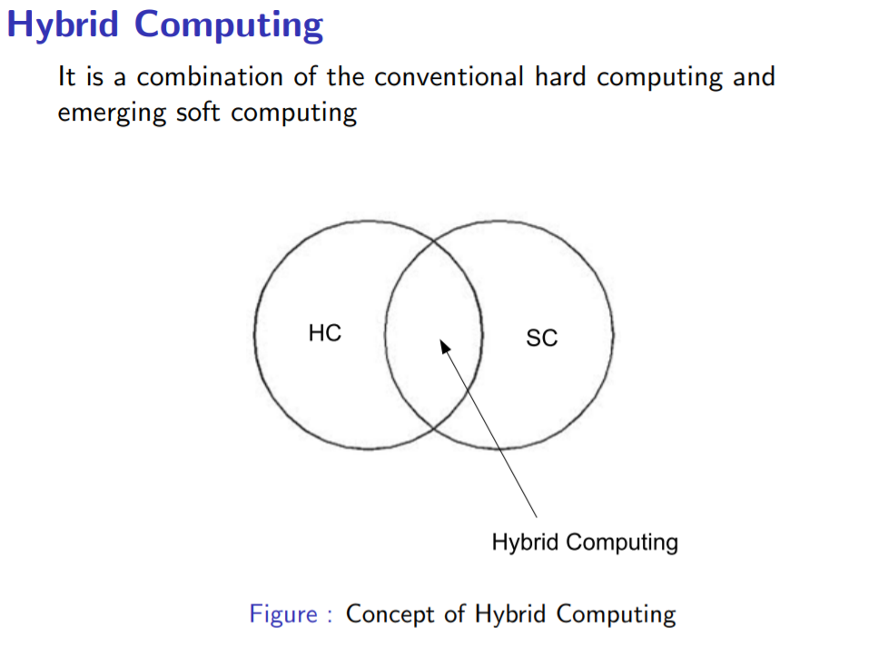
Hybrid Computing

Slide 24
In this course…. How to build an artificial neural networks and train it with input data to solve a number of problems, which are not possible to solve with hard computing. Basic concepts of fuzzy algebra and then how to solve problems using fuzzy logic. The framework of genetic algorithm and solving varieties of optimization problems.

Slide 25
MCQ
Q.1.Which of these has been associated with fuzzy logic?
a. Many-valued logic b. Crisp set logic
c. Binary set logic d. Two-valued logic
Answer: (a) Many-valued logic

Slide 26
MCQ
Q.2.Hard Computing is/are…
Deterministic (b) incorporates stochasticity
(c) Bothe a & b (d) None of these
Ans:- (a) Deterministic

Slide 27
MCQ
Q.3.Soft computing is /are…
incorporates stochasticity
(b) Deterministic (c)both a & b
(d)None of these
Ans:- (a) incorporates stochasticity i.e. refers to the property of being well described by a random probability distribution.

Slide 28
MCQ
Q.4. The term soft computing was proposed by the inventor of fuzzy logic, Lofti A. Zadeh
Charles Babbage
(b) Lofti A. Zadeh (c) Alan Turing
(d)None of these
Ans:- (b) Lofti A. Zadeh

Slide 29
Questions
Q1. Differentiate Hard Computing and Soft Computing?
Q2. What are the problems which can be solved by soft computing?

Slide 30
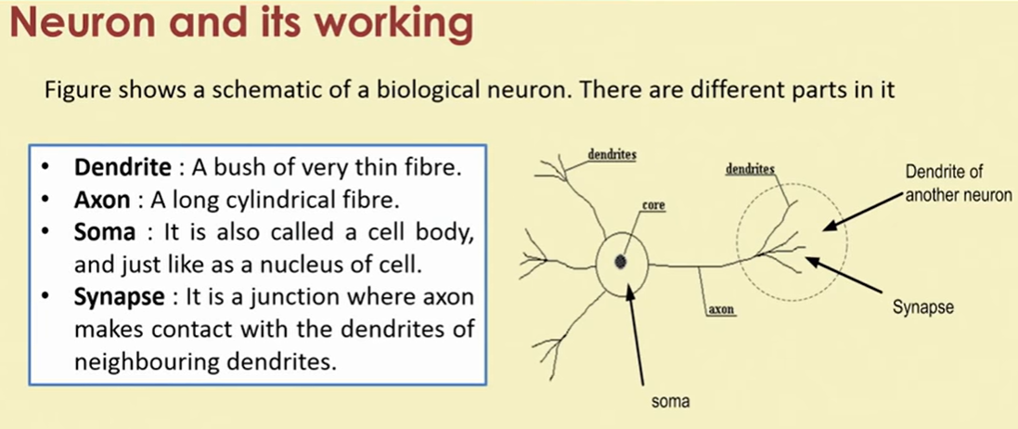
Biological nervous system

Slide 31
Neuron and its working
There is a chemical in each neuron called neurotransmitter.
A signal (also called sense) is transmitted across neurons by this chemical.
That is, all inputs from other neuron arrive to a neurons through dendrites.
These signals are accumulated at the synapse of the neuron and then serve as the output to be transmitted through the neuron. An action may produce an electrical impulse, which usually lasts for about a millisecond.
Note that this pulse generated due to an incoming signal and all signal may not produce pulses in axon unless it crosses a threshold value.
Also, note that an action signal in axon of a neuron is commutative signals arrive at dendrites which summed up at soma.

Slide 32
Brain: Center of the nervous system
Brain | Computer
1. Analogue | 1.Digital
2. uses content addressable memory | 2.Uses byte addressable memory
3. Massive parallel mechanism | 3. Serial and modular approach
4. Processing speed is not fixed; no system clock | 4. Processing speed is fixed
5.Synapses are far more complex than logic gates | 5. Easier than the architecture of Brain
6. Much bigger than any computer | 6. Not so big.

Slide 33
Artificial Neural Networks (ANNs)
Neural networks are also artificial neural networks (ANNs) or simulated neural networks (SNNs).
It is a subset of machine learning at the heart of deep learning algorithms.
Their name and structure are inspired by the human brain, mimicking the way that biological neurons signal to one another.

Slide 34
Artificial Neural Networks (ANNs)
Artificial neural networks (ANNs) are comprised of a node layers, containing an input layer, one or more hidden layers, and an output layer.
Each node, or artificial neuron, connects to another and has an associated weight and threshold.
If the output of any individual node is above the specified threshold value, that node is activated, sending data to the next layer of the network.
Otherwise, no data is passed along to the next layer of the network.

Slide 35
Artificial Neural Networks (ANNs)
Neural networks rely on training data to learn and improve their accuracy over time.
However, once these learning algorithms are fine-tuned for accuracy, they are powerful tools in computer science and artificial intelligence, allowing us to classify and cluster data at a high velocity. Tasks in speech recognition or image recognition can take lass than a minute versus hours when compared to manual identification by human experts.
One of the most well-known neural networks is Google’s search algorithm.
**Fine-Tuned:- Make minor adjustments to something in order to achieve the best or desired performance.

Slide 36
Elements of a Neural Network
Input Layer: This layer accepts input features. It provides information from the outside world to the network, no computation is performed at this layer, nodes here just pass on the information(features) to the hidden layer.
Hidden Layer: Nodes of this layer are not exposed to the outer world, they are part of the abstraction provided by any neural network. The hidden layer performs all sorts of computation on the features entered through the input layer and transfers the result to the output layer.
Output Layer: This layer bring up the information learned by the network to the outer world.

Slide 37
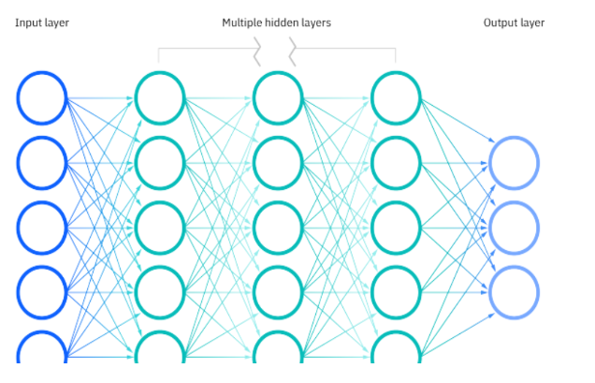
Elements Artificial Neural Networks

Slide 38
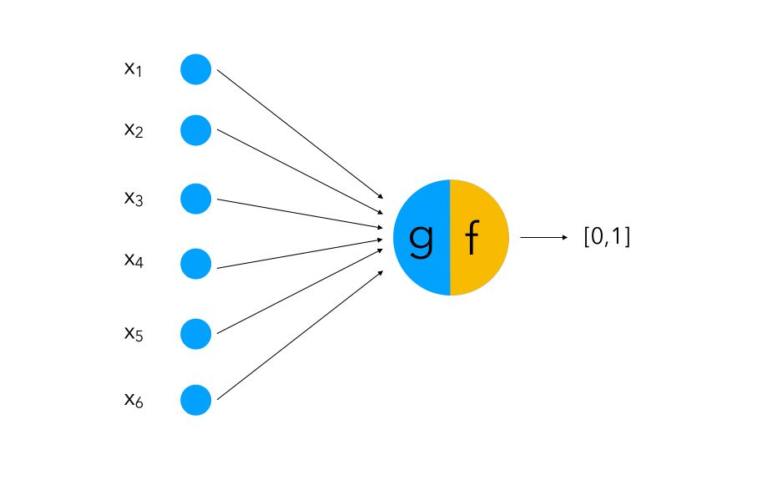
Types of neural networks
The perceptron is the oldest neural network, created by Frank Rosenblatt in 1958. Rosenblatt perceptron is a binary single-neuron model.
The inputs integration is implemented through the addition of the weighted inputs that have fixed weights obtained during the training stage.
If the result of this addition is larger than a given threshold θ the neuron fires. When the neuron fires its output is set to 1, otherwise it’s set to 0.

Slide 39
Types of neural networks
(ii) Feedforward neural networks, or multi-layer perceptron (MLPs):-They comprise an input layer, a hidden layer or layers, and an output layer. While these neural networks are also commonly referred to as MLPs, it’s important to note that they are actually comprised of sigmoid neurons. Data usually is fed into these models to train them, and they are the foundation for computer vision, natural language processing, and other neural networks.

Slide 40
Types of neural networks
(iii)Convolutional neural networks (CNNs) are similar to feedforward networks, but they’re usually utilized for image recognition, pattern recognition, and/or computer vision. These networks harness principles from linear algebra, particularly matrix multiplication, to identify patterns within an image.
(iv)Recurrent neural networks (RNNs) are identified by their feedback loops. These learning algorithms are primarily leveraged when using time-series data to predict future outcomes, such as stock market predictions or sales forecasting.

Slide 41
History of neural networks
1943: Warren S. McCulloch and Walter Pitts published “A logical calculus of the ideas immanent in Nervous. This research sought to understand how the human brain could produce complex patterns through connected brain cells or neurons. One of the main ideas that came out of this work was the comparison of neurons with a binary threshold to Boolean logic (i.e., 0/1 or true/false statements).
1958: Frank Rosenblatt is credited with the development of the perceptron, documented in his research, “The Perceptron: A Probabilistic Model for Information Storage and Organization in the Brain. He takes McCulloch and Pitt’s work a step further by introducing weights to the equation. Leveraging an IBM 704, Rosenblatt was able to get a computer to learn how to distinguish cards marked on the left vs. cards marked on the right.

Slide 42
History of neural networks
1974: While numerous researchers contributed to the idea of backpropagation, Paul Werbos was the first person in the US to note its application within neural networks within his PhD thesis.
1989: Yann LeCun published a paper illustrating how the use of constraints in backpropagation and its integration into the neural network architecture can be used to train algorithms. This research successfully leveraged a neural network to recognize hand-written zip code digits provided by the U.S. Postal Service.

Slide 43
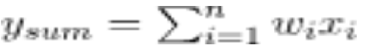
Neuron Components
(i) A set of ‘i’ synapses having weight wi. A signal xi forms the input to the i-th synapse having weight wi. The value of any weight may be positive or negative. A positive weight has an extraordinary effect, while a negative weight has an inhibitory effect on the output of the summation junction.
(ii) A summation junction for the input signals is weighted by the respective synaptic weight. Because it is a linear combiner or adder of the weighted input signals, the output of the summation junction can be expressed as follows:

Slide 44
Neuron Components
(iii) A threshold activation function (or simply the activation function, also known as a squashing function) results in an output signal only when an input signal exceeding a specific threshold value comes as an input. It is similar in behaviour to the biological neuron, which transmits the signal only when the total input signal meets the firing threshold.
** Threshold Value:- Reflects the minimum performance required to achieve the required operational effect while being achievable through
the current state of technology at an affordable life-cycle cost.

Slide 45
Types of Activation Function
The most commonly used activation function are listed below:
Identity Function
Threshold/step Function
ReLU (Rectified Linear Unit) Function
Sigmoid Function
Hyperbolic Tangent Function

Slide 46
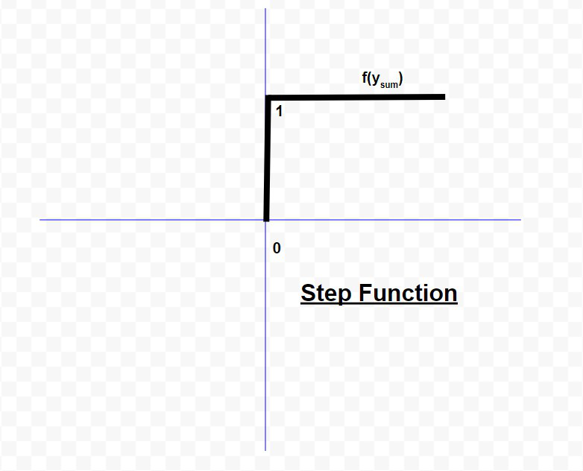
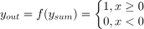
Types of Activation Function
It’s just a thing function that you use to get the output of node. It is also known as Transfer Function.
(i) Identity Function: The identity function is used as an activation function for the input layer. The identity function is a special case of an activation function where the output signal is equal to the input signal. In other words, the identity function simply passes the input signal through unchanged. It is a linear function having the form:
(ii) Threshold/step Function: It is a commonly used activation function. As depicted in the diagram, it gives 1 as an output of the input is either 0 or positive. If the input is negative, it gives 0 as output. Expressing it mathematically,

Slide 47
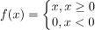
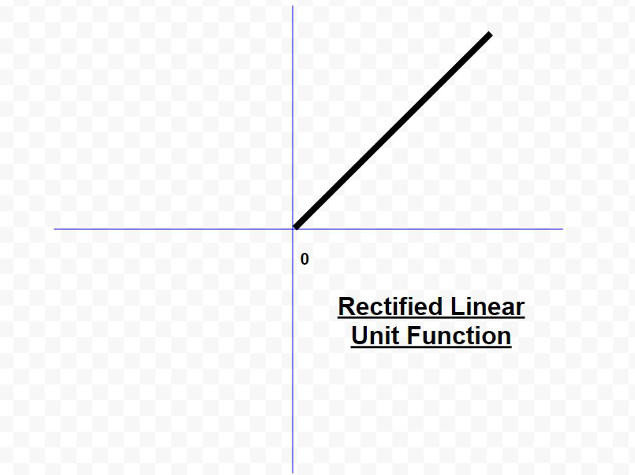
Types of Activation Function
(iii) ReLU (Rectified Linear Unit) Function: It is the most popularly used activation function in the areas of convolutional neural networks and deep learning. It is of the form:
This means that f(x) is zero when x is less than zero and f(x) is equal to x when x is above or equal to zero. This function is differentiable, except at a single point x = 0. In that sense, the derivative of a ReLU is actually a sub-derivative.

Slide 48
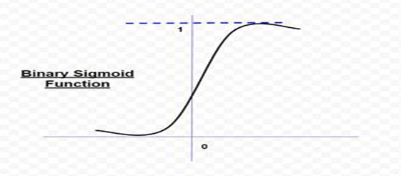
(iv) Sigmoid Function: It is by far the most commonly used activation function in neural networks. The need for sigmoid function stems from the fact that many learning algorithms require the activation function to be differentiable and hence continuous. There are two types of sigmoid function:
(a). Binary Sigmoid Function:-A binary sigmoid function is of the form
Where k = steepness or slope parameter, By varying the value of k, sigmoid function with different slopes can be obtained. It has a range of (0,1). The slope of origin is k/4. As the value of k becomes very large, the sigmoid function becomes a threshold function.

Slide 49
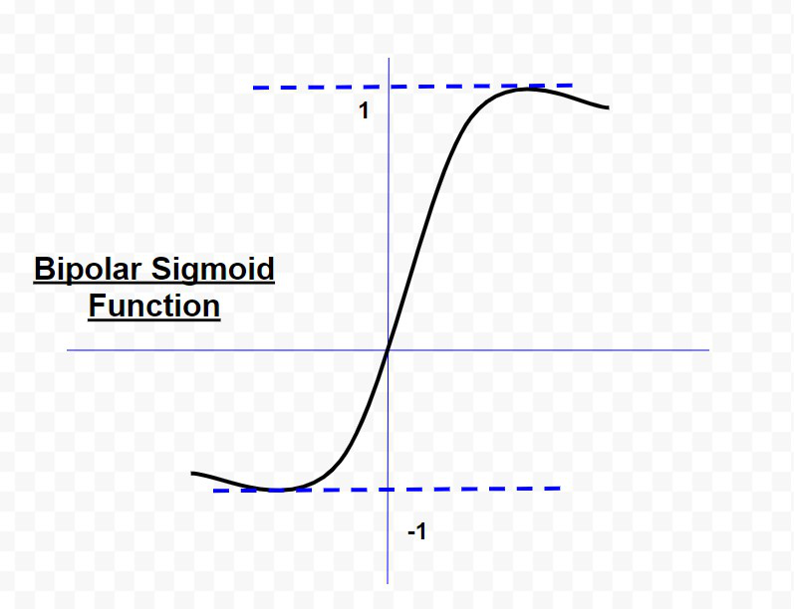
(b)Bipolar Sigmoid Function
A bipolar sigmoid function is of the form
The range of values of sigmoid functions can be varied depending on the application. However, the range of (-1,+1) is most commonly adopted.

Slide 50
(v) Hyperbolic Tangent Function
It is bipolar in nature. It is a widely adopted activation function for a special type of neural network known as Backpropagation Network. The hyperbolic tangent function is of the form
This function is similar to the bipolar sigmoid function.

Slide 51
Artificial neural network
In fact, the human brain is a highly complex structure viewed as a massive, highly interconnected network of simple processing elements called neurons.
Artificial neural networks (ANNs) or simply we refer it as neural network (NNs), which are simplified models (i.e. imitations) of the biological nervous system, and obviously, therefore, have been motivated by the kind of computing performed by the human brain.
The behavior of a biolgical neural network can be captured by a simple model called artificial neural network.

Slide 52
Task of a Neuron
We may note that a neutron is a part of an interconnected network of nervous system and serves the following.
Compute input signals
Transportation of signals (at a very high speed)
Storage of information
Perception, automatic training and learning
We also can see the analogy between the biological neuron and artificial neuron. Truly, every component of the model (i.e. artificial neuron) bears a direct analogy to that of a biological neuron. It is this model which forms the basis of neural network (i.e. artificial neural network).

Slide 53
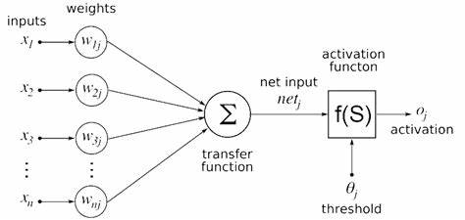
Artificial neural network

Slide 54
Artificial neural network
Here, x₁, x_{2,} · · · , x_{n} are the n inputs to the artificial neuron. w₁, w₂, · · · , w_{n} are weights attached to the input links.
Note that, a biological neuron receives all inputs through the dendrites, sums them and produces an output if the sum is greater than a threshold value.
The input signals are passed on to the cell body through the synapse, which may accelerate or retard an arriving signal.
It is this acceleration or retardation of the input signals that is modeled by the weights.
An effective synapse, which transmits a stronger signal will have a correspondingly larger weights while a weak synapse will have smaller weights.
Thus, weights here are multiplicative factors of the inputs to account for the strength of the synapse.

Slide 55
Artificial Neural Network
Hence, the total input say I received by the soma of the artificial neuron is I = w₁x₁ + w₂x₂ + · · · + w_{n}x_{n} = ∑^{n}_{i=1} w_{i}x_{i}
To generate the final output y, the sum is passed to a filter φ called transfer function, which releases the output. That is, y = φ(I).

Slide 56
Mathematical Understanding
A very commonly known transfer function is the thresholding function.
In this thresholding function, sum (i.e. I) is compared with a threshold value θ.
If the value of I is greater than θ, then the output is 1 else it is 0 (this is just like a simple linear filter).
In other words, y = φ( ∑ ^{n}_{i=1} w_{i}x_{i} − θ)
where φ(I) = 1 , if I > θ
0 , if I ≤ θ Such a Φ is called step function (also known as Heaviside function).

Slide 57
MCQ
1. Why do we need biological neural networks?
a) to solve tasks like machine vision & natural language processing
b) to apply heuristic search methods to find solutions of problem
c) to make smart human interactive & user friendly system
d) all of the mentioned
Answer: d -Explanation: These are the basic aims that a neural network achieve.
2. What is the trend in software nowadays?
a) to bring computer more & more closer to user
b) to solve complex problems
c) to be task specific
d) to be versatile
Answer: a- Explanation: Software should be more interactive to the user, so that it can understand its problem in a better fashion.

Slide 58
MCQ
3. What’s the main point of difference between human & machine intelligence?
a) human perceive everything as a pattern while machine perceive it merely as data
b) human have emotions
c) human have more IQ & intellect
d) human have sense organs
Answer: a -Explanation: Humans have emotions & thus form different patterns on that basis, while a machine(say computer) is dumb & everything is just a data for him.

Slide 59
MCQ
4. What is auto-association task in neural networks?
a) find relation between 2 consecutive inputs
b) related to storage & recall task
c) predicting the future inputs
d) none of the mentioned
Answer: b - Explanation: This is the basic definition of auto-association in neural networks.
5. Does pattern classification belongs to category of non-supervised learning?
a) yes
b) no
Answer: b - Explanation: Pattern classification belongs to category of supervised learning.

Slide 60
MCQ
6. In pattern mapping problem in neural nets, is there any kind of generalization involved between input & output?
a) yes
b) no
Answer: a - Explanation: The desired output is mapped closest to the ideal output & hence there is generalisation involved.
7. What is unsupervised learning?
a) features of group explicitly stated
b) number of groups may be known
c) neither feature & nor number of groups is known
d) none of the mentioned
Answer: c - Explanation: Basic definition of unsupervised learning.

Slide 61
MCQ
8. Does pattern classification & grouping involve same kind of learning?
a) yes
b) no
Answer: b - Explanation: Pattern classification involves supervised learning while grouping is an unsupervised one.
9. Does for feature mapping there’s need of supervised learning?
a) yes
b) no
Answer: b - Explanation: Feature mapping can be unsupervised, so it’s not a sufficient condition.

Slide 62
MCQ
10. The fundamental unit of network is
a) brain
b) nucleus
c) neuron
d) axon
Answer: c - Explanation: Neuron is the most basic & fundamental unit of a network .
11. What are dendrites?
a) fibers of nerves
b) nuclear projections
c) other name for nucleus
d) none of the mentioned
Answer: a - Explanation: Dendrites tree shaped fibers of nerves.

Slide 63
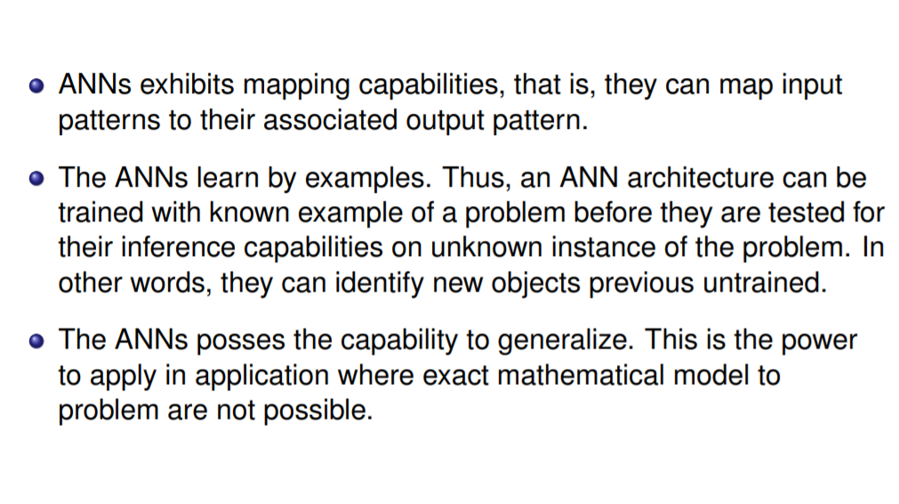
Advantages of ANN

Slide 64
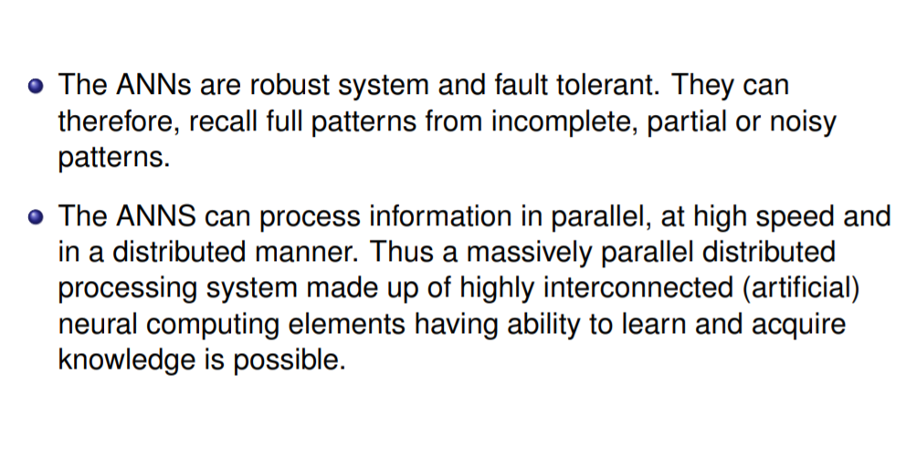
Advantages of ANN

Slide 65
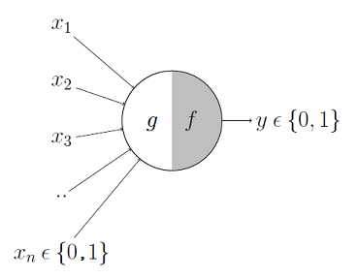
MuCulloch & Pitt Model
The first computational model of a neuron was proposed by Warren MuCulloch (neuroscientist) and Walter Pitts (logician) in 1943.
It may be divided into 2 parts. The first part, g takes an input, performs an aggregation and based on the aggregated value the second part, f makes a decision.
The McCulloch-Pitts neural model has only two types of inputs Excitatory and Inhibitory.

Slide 66
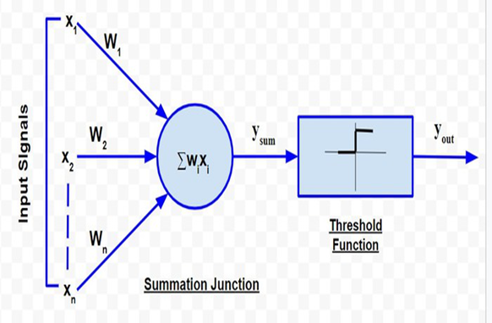
MuCulloch & Pitt Model
The excitatory inputs have weights of positive magnitude and the inhibitory weights have weights of negative magnitude.
The inputs of the McCulloch-Pitts neuron could be either 0 or 1.
It has a threshold function as an activation function. So, the output signal y_{out} is 1 if the input y_{sum} is greater than or equal to a given threshold value, else 0.
The diagrammatic representation of the model is as follows:

Slide 67
MuCulloch & Pitt Model
McCulloch-Pitts neurons can be used to design logical operations. For that purpose, the connection weights need to be correctly decided along with the threshold .
Example:
John carries an umbrella if it is sunny or if it is raining. There are four given situations. I need to decide when John will carry the umbrella. The situations are as follows:
First scenario: It is not raining, nor it is sunny
Second scenario: It is not raining, but it is sunny
Third scenario: It is raining, and it is not sunny
Fourth scenario: It is raining as well as it is sunny
To analyse the situations using the McCulloch-Pitts neural model, I can consider the input signals as follows:
X₁: Is it raining?
X₂ : Is it sunny?

Slide 68
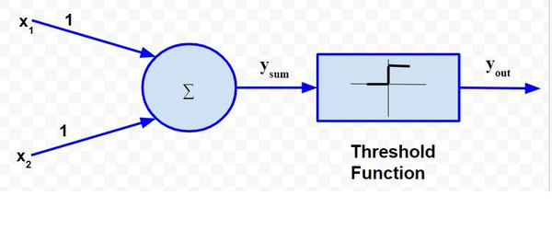
MuCulloch & Pitt Model
So, the value of both scenarios can be either 0 or 1. We can use the value of both weights X₁ and X₂ as 1 and a threshold function as 1. So, the neural network model will look like:

Slide 69
MuCulloch & Pitt Model
Truth Table for this case will be:
Situation | x₁ | x₂ | y_{sum} | y_{out}
1 | 0 | 0 | 0 | 0
2 | 0 | 1 | 1 | 1
3 | 1 | 0 | 1 | 1
4 | 1 | 1 | 2 | 1

Slide 70

Example 2
A bank wants to decide if it can sanction a loan or not. There are 2 parameters to decide- Salary and Credit Score. So there can be 4 scenarios to assess-
(i) High Salary and Good Credit Score (ii) High Salary and Bad Credit Score
(iii) Low Salary and Good Credit Score (iv) Low Salary and Bad Credit Score
Let X1 = 1 denote high salary and X1 = 0 denote Low salary and X2 = 1 denote good credit score and X2 = 0 denote bad credit score.
Let the threshold value be 2.

Slide 71
Example 2
A bank wants to decide if it can sanction a loan or not. There are 2 parameters to decide- Salary and Credit Score. So there can be 4 scenarios to assess-
(i) High Salary and Good Credit Score (ii) High Salary and Bad Credit Score
(iii) Low Salary and Good Credit Score (iv) Low Salary and Bad Credit Score
Let X1 = 1 denote high salary and X1 = 0 denote Low salary and X2 = 1 denote good credit score and X2 = 0 denote bad credit score.Let the threshold value be 2. The truth table is as follows
The truth table shows when the loan should be approved considering all the varying scenarios. In this case, the loan is approved only if the salary is high and the credit score is good. The McCulloch Pitt's model of neuron was mankind’s first attempt at mimicking the human brain. And it was a fairly simple one too. It’s no surprise it had many limitations-
The model failed to capture and compute cases of non-binary inputs. It was limited by its ability to compute every case with 0 and 1 only.
The threshold had to be decided beforehand and needed manual computation instead of the model deciding itself.
X1 | X2 | X1+X2 | Loan approved
1 | 1 | 2 | 1
1 | 0 | 1 | 0
0 | 1 | 1 | 0
0 | 0 | 0 | 0

Slide 72
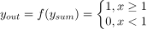
MuCulloch & Pitt Model
So, I can say that,
From the truth table, I can conclude that in the situations where the value of y_{out} is 1, John needs to carry an umbrella. Hence, he will need to carry an umbrella in scenarios 2, 3 and 4.

Slide 73
Learning methods in PERCEPTRON
Supervised Learning:-Perceptron is a machine learning algorithm for supervised learning of binary classifiers. In Perceptron, the weight coefficient is automatically learned. Initially, weights are multiplied with input features, and the decision is made whether the neuron is fired or not.
Every input pattern that is used to train the network associated with an output pattern, which is the target pattern.
Supervised learning is a process of providing input data as well as correct output data to the machine learning model.
The aim of a supervised learning algorithm is to find a mapping function to map the input variable(x) with the output variable(y).

Slide 74
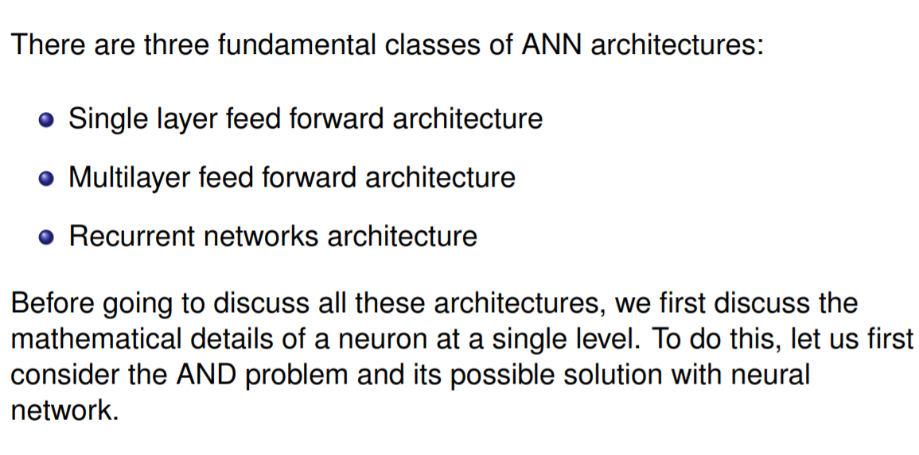
Types of ANN Architecture

Slide 75
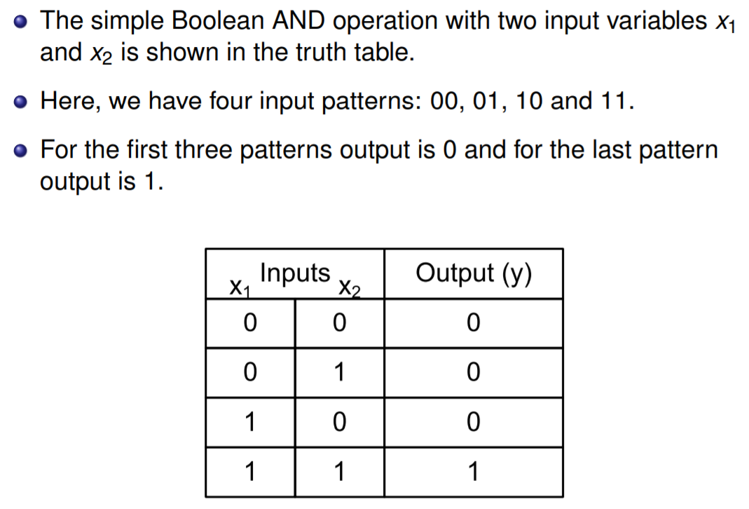
AND Problem and its Neural Network

Slide 76
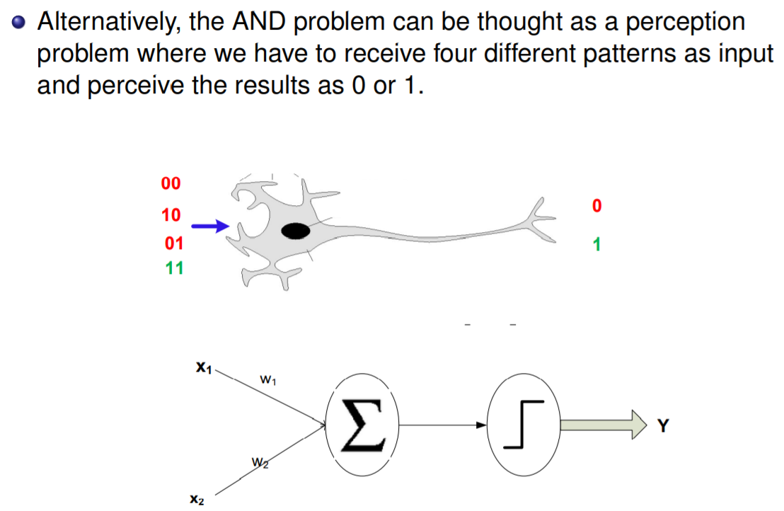
AND Problem and its Neural Network

Slide 77
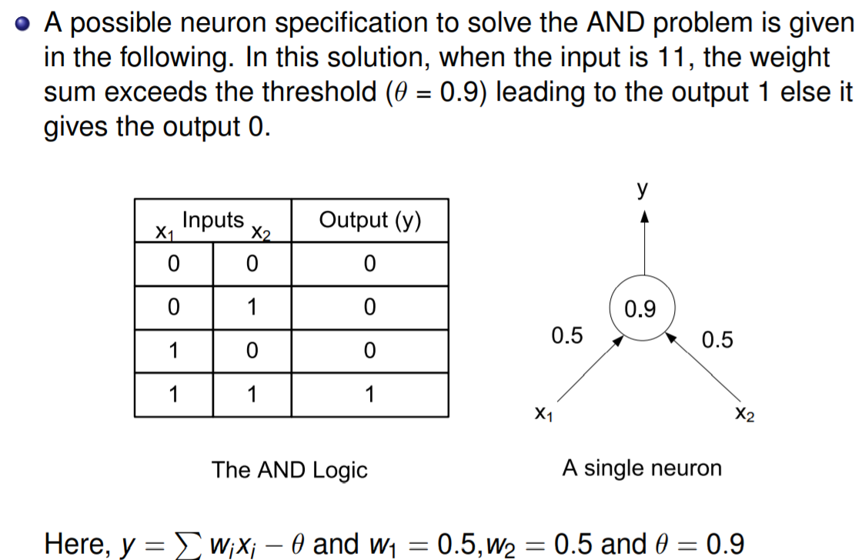
AND Problem and its Neural Network

Slide 78

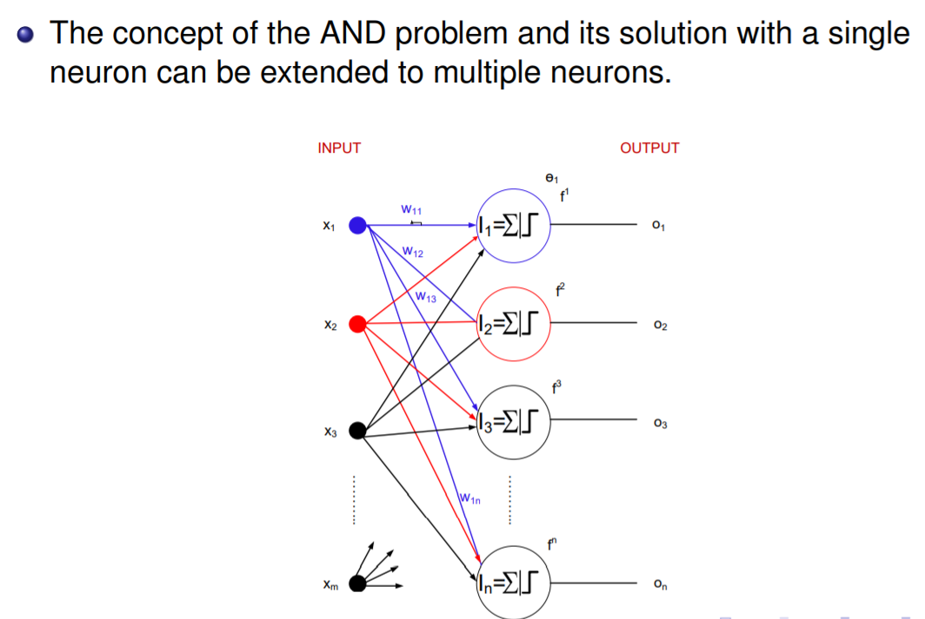
Single layer feed forward Neural Network

Slide 79
Single layer feed forward Neural Network
We see, a layer of n neurons constitutues a single layer feed forward neural network.
This is so called because, it contains a single layer of artificial neurons.
Note that the input layer and output layer, which receive input signals and transmit output signals are although called layers, they are actually boundary of the architecture and hence truly not layers.
The only layer in the architecture is the synaptic links carrying the weights connect every input to the output neurons.

Slide 80

Modeling SLModelling SLFFNNFFNN
In a single layer neural network, the inputs x₁, x₂, · · · , x_{m} are connected to the layers of neurons through the weight matrix W . The weight matrix W_{m×n} can be represented as follows.
(1)
The output of any k -th neuron can be determined as follows.
where k = 1, 2, 3, · · · , n and θ_{k} denotes the threshold value of the k-th neuron. Such network is feed forward in type or acyclic in nature and hence the name.

Slide 81
Multi layer feed forward Neural Network
This network, as its name indicates is made up of multiple layers.
Thus architectures of this class besides processing an input and an output layer also have one or more intermediary layers called hidden layers.
The hidden layer(s) aid in performing useful intermediary computation before directing the input to the output layer.
A multilayer feed forward network with l input neurons (number of neuron at the first layer), m₁, m₂, · · · , m_{p} number of neurons at i-th hidden layer (i = 1, 2, · · · , p) and n neurons at the last layer (it is the output neurons) is written as l − m₁ − m₂ − · · · − m_{p} − n MLFFNN.

Slide 82
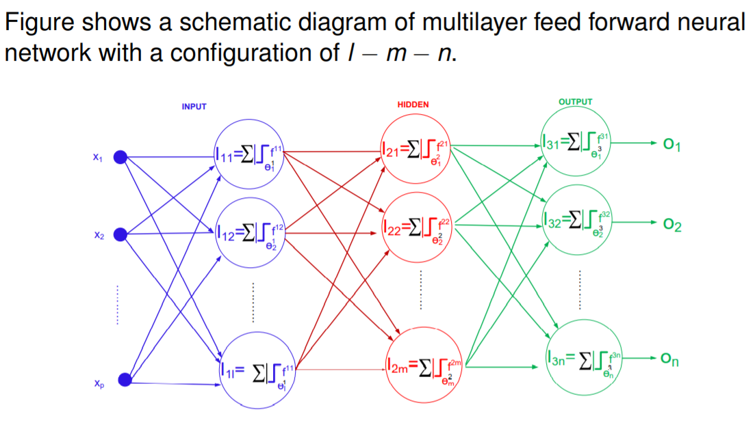
Multi layer feed forward Neural Network

Slide 83
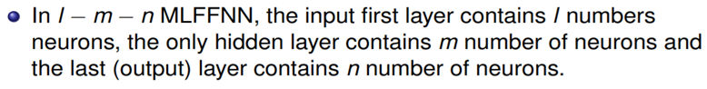
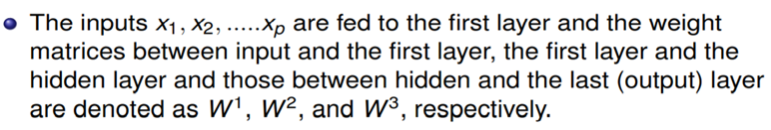
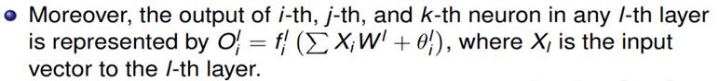
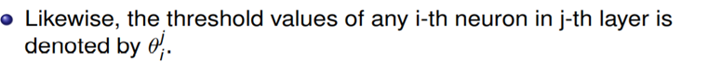
Multi layer feed forward Neural Network

Slide 84
Recurrent Neural network Architecture
The networks differ from feedback network architectures in the sense that there is at least one ”feedback loop”.
Thus, in these networks, there could exist one layer with feedback connection.
There could also be neurons with self-feedback links, that is, the output of a neuron is fed back into itself as input.

Slide 85
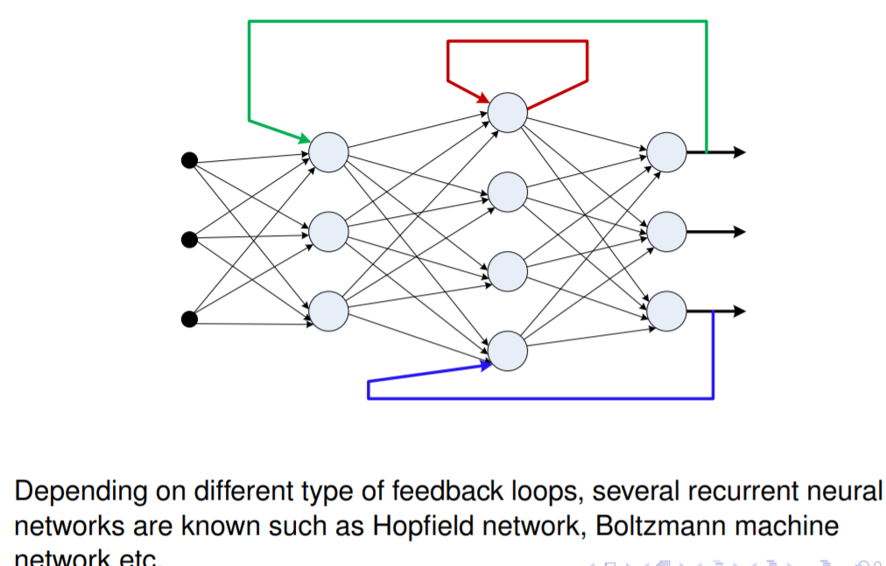
Recurrent neural Network

Slide 86
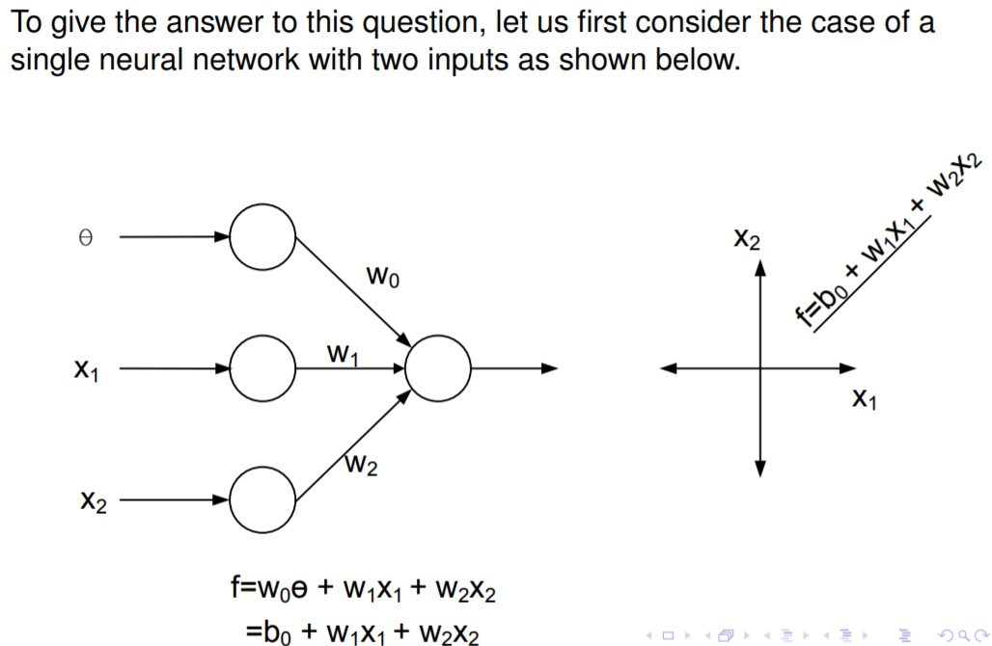
Why Different types of neural network

Slide 87
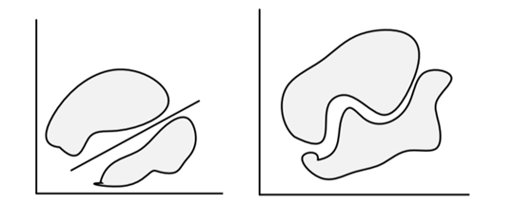
Revisit of a single neural network

Slide 88
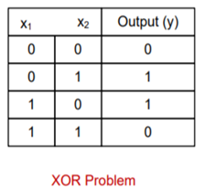
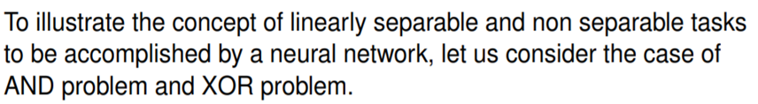
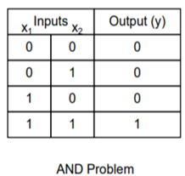
AND and XOR problems

Slide 89
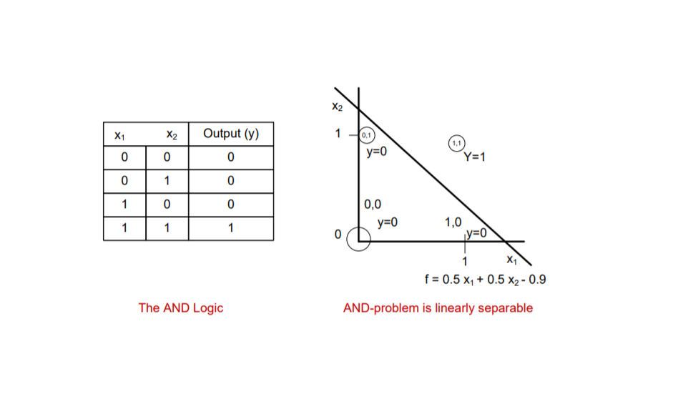
AND problem is linearly separable

Slide 90
AND problem is linearly separable

Slide 91
MCQ
For problems, with error calculation, we solve using
(a) Recurrent neural networks
(b) Single layer feed forward neural network
(c) Multilayer feed forward neural network
(d) All of the above
Answer: (a) Recurrent neural networks
Application of Neural Network includes
(a) Pattern Recognition
(b) Classification
(c) Clustering
(d) All of the above
Answer: (d) All of the above

Slide 92
MCQ
Introduction to ANN
1) An ANN learn quickly if ŋ, the learning rate assumes the following value(s).
(a) ŋ = 1
(b) ŋ < 1
(c) ŋ > 1
(d) ŋ = 0
Answer: (c) ŋ > 1
2) Which of the following is true for neural networks?
i. The training time depends on the size of the network.
ii. Neural networks can be simulated on a conventional computer.
iii. Artificial neurons are identical in operation to biological ones.
(a) i and ii are true
(b) i and iii are true
(c) ii is true.
(d) all of them are true
Answer: (b) i and iii are true

Slide 93
MCQ
3) Which of the following is true for neural networks?
i. The error calculation which is followed in “Back-propagation algorithm” is the
steepest descent method.
ii. Simulated annealing approach is followed in unsupervised learning.
iii. A problem whose output is linearly separable can also be solved with MLFFNN.
iv. The output of the perceptron with hard limit transfer function is more accurate than
it is defined with any sigmoid transfer function.
(a) i and iii are true
(b) i and ii are true
(c) ii and iv are true
(d) all are true
Answer: (a) i and iii are true

Slide 94
MCQ
4) A possible neuron specification to solve the AND problem requires a minimum of
(a) Single neuron
(b) Two neurons
(c) Three neurons
(d) Four neurons
Answer: (a) Single neuron
5) What is back propagation?
(a) It is another name given to the curvy function in the perceptron
(b) It is the transmission of error back through the network to adjust the inputs
(c) It is the transmission of error back through the network to allow weights to be
adjusted so that the network can learn
(d) None of the above
Answer: (c) It is the transmission of error back through the network to allow weights to be
adjusted so that the network can learn

Slide 95
MCQ
What is perceptron in Neural network
(a) It is an auto-associative neural network
(b) It is a double layer auto-associative neural network
(c) It is a single layer feed-forward neural network with pre-processing
(d) It is a neural network that contains feedback
Answer: (c) It is a single layer feed-forward neural network with pre-processing
Neural Networks are complex ______________ with many parameters
(a) Linear Functions
(b) Nonlinear Functions
(c) Discrete Functions
(d) Exponential Functions
Answer: (a) Linear Functions

Slide 96
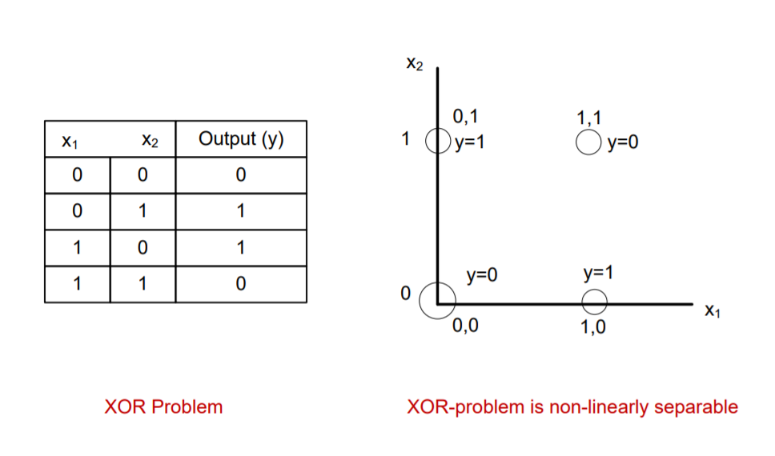
XOR problem is linearly non-separable

Slide 97
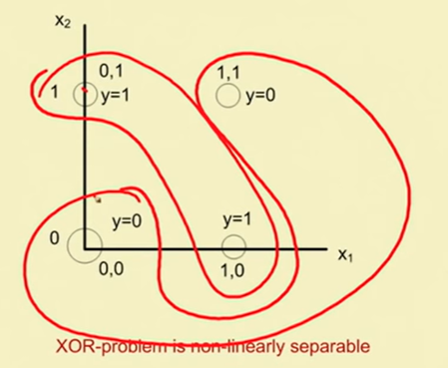
XOR problem is linearly non-separable

Slide 98
Our observations
From the example discussed,
we understand that a straight line is possible in AND-problem to separate two tasks namely the output as 0 or 1 for any input.
However, in case of XOR problem, such a line is not possible. Note: horizontal or a vertical line in case of XOR problem is not admissible because in that case it completely ignores one input.

Slide 99
Our observations
In fact, any linearly separable problem can be solved with a single layer feed forward neural network. For example, the AND problem.
On the other hand, if the problem is non-linearly separable, then a single layer neural network can not solves such a problem. To solve such a problem, multilayer feed forward neural network is required.

Slide 100
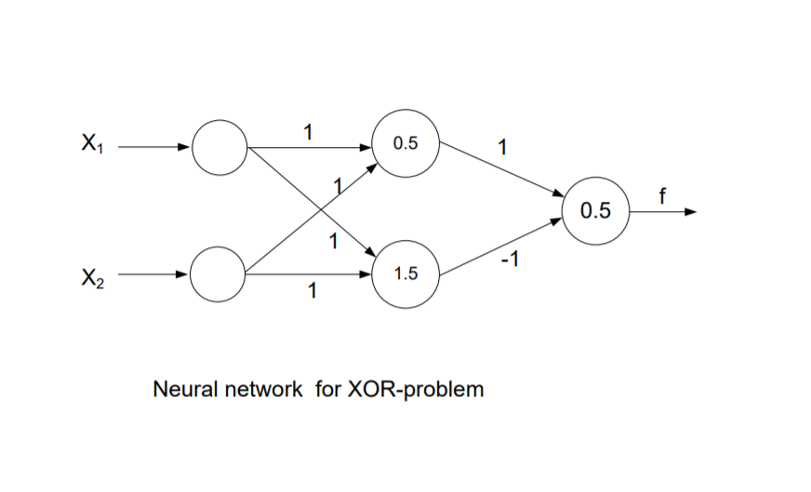
Solution of XOR Problem

Slide 101
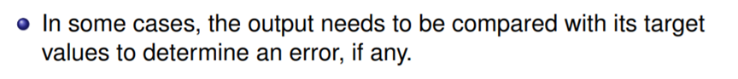
Dynamic neural Network

Slide 102
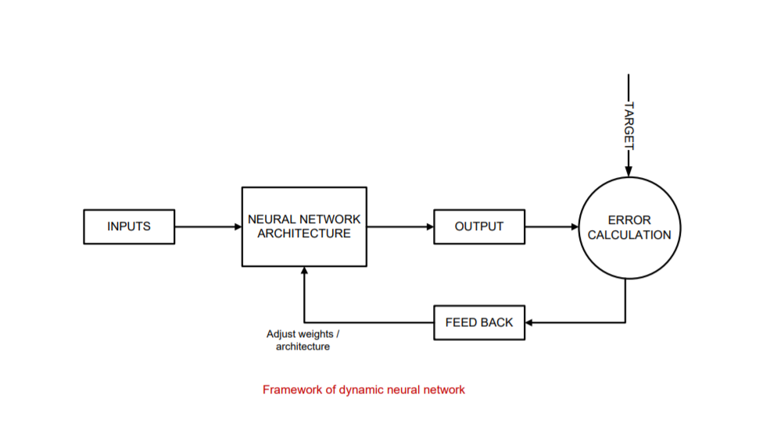
Dynamic neural Network

Slide 103
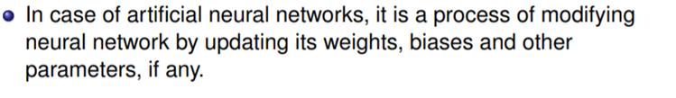
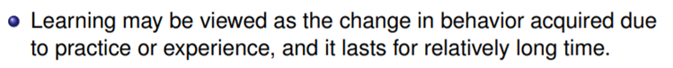
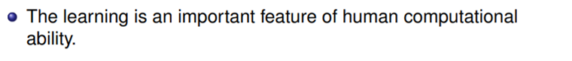
Concept of Learning in neural Network

Slide 104

Types of Learning

Slide 105

Supervised Learning

Slide 106
Unsupervised Learning

Slide 107
Reinforcement Learning

Slide 108
Different learning techniques : Gradient descent learning

Slide 109
Different learning techniques: Stochastic learning
**A stochastic policy requires learning a probability distribution over actions, which can be challenging. On the other hand, a deterministic policy only requires selecting the best action for each state, which is relatively easy.

Slide 110

Different learning techniques: Hebbian learning

Slide 111
Different learning techniques: Competitive learning

Slide 112
Linearly Separable Task & XOR Problem
Classification algorithms like Logistic Regression and Naive Bayes only work on linearly separable problems.
Def.:- Linear Separability refers to the data points in binary classification problems which can be separated using linear decision boundary.
If the data points can be separated using a line, linear function, or flat hyperplane are considered linearly separable.
Linear separability is an important concept in neural networks.

Slide 113

Linearly Separable Task & XOR Problem
Consider a data set with two attributes x₁ and x₂ and two classes 0 and 1. Let class 0 = o and class 1 = x.
A straight line (or plane) can be used to separate the two classes (i.e. the x’s from the o’s). In other words, a single decision surface can be used as the boundary between both classes.

Slide 114

XOR Problem
The XOR function is not linearly separable, which means we cannot draw a single straight line to separate the inputs that yield different outputs.
The XOR problem with neural networks can be solved by using Multi-Layer Perceptrons or a neural network architecture with an input layer, hidden layer, and output layer. So during the forward propagation through the neural networks, the weights get updated to the corresponding layers and the XOR logic gets executed.
The Neural network architecture to solve the XOR problem will be as shown below:-

Slide 115
XOR Problem
So with this overall architecture and certain weight parameters between each layer, the XOR logic output can be yielded through forward propagation.
The overall neural network architecture uses the Relu activation function to ensure the weights updated in each of the processes to be 1 or 0 accordingly where for the positive set of weights the output at the particular neuron will be 1 and for a negative weight updation at the particular neuron will be 0 respectively.
So let us understand one output for the first input state

Slide 116

Multilayer Perceptron
The single-layer networks suffer from the disadvantage that they are only able to solve linearly separable classification problems.
The MLP is a hierarchical structure of several perceptron, & overcomes the disadvantages of these single-layer networks.
However the computational effort needed for finding the correct combination of weights increases substantially when more parameters and more complicated topologies are considered.

Slide 117
Architecture of Multilayer Perceptron
No connections within a layer
No direct connections between input and output layers
Fully connected between layers
No. of output units need not equal no. of input units
No. of hidden units per layer can be more or less than input or output units
Each unit is a perceptron
The training algorithm for MLP requires differentiable, continuous nonlinear activation functions.
**The non-linear functions are known to be the most used activation functions. It makes it easy for a neural network model to adapt with a variety of data and to differentiate between the outcomes.
These functions are mainly divided basis on their range or curves,
Such as Sigmoid Activation Functions
Sigmoid takes a real value as the input and outputs another value between 0 and 1. The sigmoid activation function translates the input ranged in (-∞,∞) to the range in (0,1)

Slide 118



Slide 133
Back Propagation Algorithm
The BP algorithm is used to find a local minimum of the error function.
The network is initialized with randomly chosen weights.
The gradient of the error function is computed and used to correct the initial weights.
The back propagation algorithm includes two passes through the network: (i) forward pass (ii) backward pass.

Slide 134

Back Propagation Algorithm

Slide 135
The BP Algorithm – what it actually does!
BP attempts to reduce the errors between the output of the network and the desired result.
However, assigning blame for errors to hidden nodes, is not so straightforward. The error of the output nodes must be propagated back through the hidden nodes.
The contribution that a hidden node makes to an output node is related to the strength of the weight on the link between the two nodes and the level of activation of the hidden node when the output node was given the wrong level of activation.
This can be used to estimate the error value for a hidden node in the penultimate layer, and that can, in turn, be used in making error estimates for earlier layers.

Slide 136
Back Propagation Learning
Back-propagation is the essence of neural net training.
It is the practice of fine-tuning the weights of a neural net based on the error rate (i.e. loss) obtained in the previous epoch (i.e. iteration). Proper tuning of the weights ensures lower error rates, making the model reliable by increasing its generalization.

Slide 137
How Back Propagation Algorithm Works
The backpropagation algorithm works by computing the gradient of the loss function with respect to each weight by the chain rule, computing the gradient one layer at a time, iterating backward from the last layer to avoid redundant calculations of intermediate terms in the chain rule.

Slide 138
Adaline network
A network with a single linear unit is called Adaline (Adaptive Linear Neural).
A unit with a linear activation function is called a linear unit. In Adaline, there is only one output unit and output values are bipolar (+1,-1).
Weights between the input unit and output unit are adjustable. It uses the delta rule i.e , where, and are the weight, predicted output, and true value respectively.
The learning rule is found to minimize the mean square error between activation and target values.
Adaline consists of trainable weights, it compares actual output with calculated output, and based on error training algorithm is applied.

Slide 139

Adaline network

Slide 140

Adaline network
In Adaline, all the input neuron is directly connected to the output neuron with the weighted connected path. There is a bias b of activation function 1 is present.

Slide 142
Problem: Design OR gate using Adaline Network?
Solution :
Initially, all weights are assumed to be small random values, say 0.1, and set learning rule to 0.1. Also, set the least squared error to 2. The weights will be updated until the total error is greater than the least squared error.
x₁ | x₂ | t
1 | 1 | 1
1 | -1 | 1
-1 | 1 | 1
-1 | -1 | -1

Slide 143
Problem: Design OR gate using Adaline Network?
Solution :
Initially, all weights are assumed to be small random values, say 0.1, and set learning rule to 0.1. Also, set the least squared error to 2. The weights will be updated until the total error is greater than the least squared error.
x₁ | x₂ | t
1 | 1 | 1
1 | -1 | 1
-1 | 1 | 1
-1 | -1 | -1

Slide 144
Similarly, repeat the same steps for other input vectors and you will get.
x₁ | x₂ | t | y_{in} | (t-y_{in}) | ∆w₁ | ∆w₂ | ∆b | w₁ (0.1) | w₂ (0.1) | b (0.1) | (t-y_{in})^2
1 | 1 | 1 | 0.3 | 0.7 | 0.07 | 0.07 | 0.07 | 0.17 | 0.17 | 0.17 | 0.49
1 | -1 | 1 | 0.17 | 0.83 | 0.083 | -0.083 | 0.083 | 0.253 | 0.087 | 0.253 | 0.69
-1 | 1 | 1 | 0.087 | 0.913 | -0.0913 | 0.0913 | 0.0913 | 0.1617 | 0.1783 | 0.3443 | 0.83
-1 | -1 | -1 | 0.0043 | -1.0043 | 0.1004 | 0.1004 | -0.1004 | 0.2621 | 0.2787 | 0.2439 | 1.01
This is epoch 1 where the total error is 0.49 + 0.69 + 0.83 + 1.01 = 3.02 so more epochs will run until the total error becomes less than equal to the least squared error i.e 2.

Slide 146
Madaline (Multiple Adaptive Linear Neuron) Network
The Madaline(supervised Learning) model consists of many Adaline in parallel with a single output unit.
The Adaline layer is present between the input layer and the Madaline layer hence Adaline layer is a hidden layer.
The weights between the input layer and the hidden layer are adjusted, and the weight between the hidden layer and the output layer is fixed.
It may use the majority vote rule, the output would have an answer either true or false. Adaline and Madaline layer neurons have a bias of ‘1’ connected to them. use of multiple Adaline helps counter the problem of non-linear separability.

Slide 147

Madaline (Multiple Adaptive Linear Neuron) Network
There are three types of a layer present in Madaline First input layer contains all the input neurons, the Second hidden layer consists of an adaline layer, and weights between the input and hidden layers are adjustable and the third layer is the output layer the weights between hidden and output layer is fixed they are not adjustable.

Slide 148

Madaline (Multiple Adaptive Linear Neuron) Network

Slide 149

Madaline (Multiple Adaptive Linear Neuron) Network

Slide 150
Problem: Using the Madaline network, implement XOR function with bipolar inputs and targets. Assume the required parameter for the training of the network.
Training pattern for XOR function :

Slide 151

Problem: Using the Madaline network, implement XOR function with bipolar inputs and targets. Assume the required parameter for the training of the network.

Slide 152

Problem: Using the Madaline network, implement XOR function with bipolar inputs and targets. Assume the required parameter for the training of the network.

